Slide 2
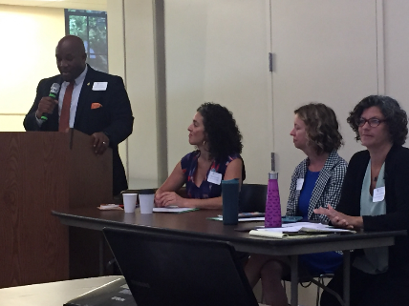
SYMPOSIUM 2017
August 16th, 2017- 9 AM to Noon
Friends Center, Philadelphia PA
WELCOMING REMARKS
Obinna I. Abara, Esq., Vice President,
Board of Directors

Slide 3
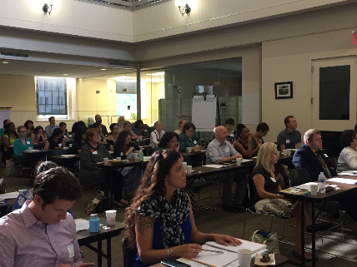
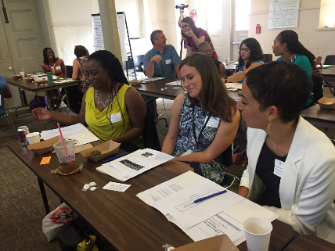
More than 70 leaders from Philadelphia’s youth-serving nonprofit organizations in attendance…

Slide 4
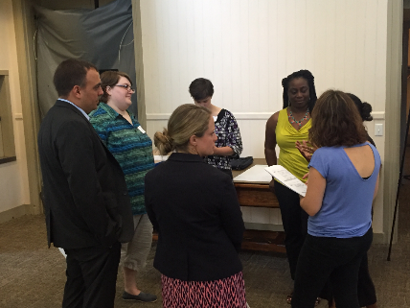
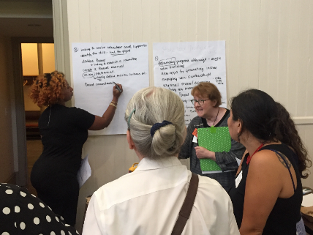
A morning dedicated to sharing, learning and networking together

Slide 5
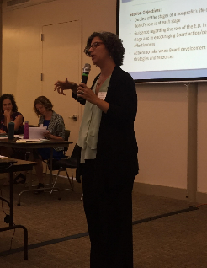
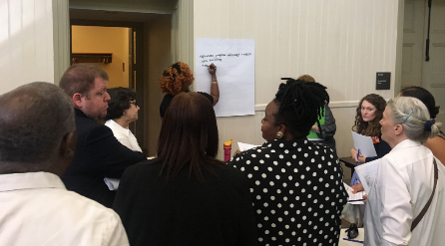
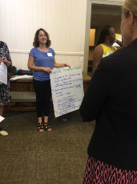
Session 1
Building an Effective Board at Every Stage of the Organizational Lifecycle
Presenter: Ellen Greenberg, Partnering for Change

Slide 6
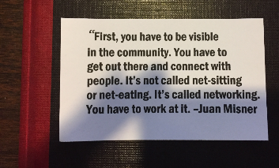
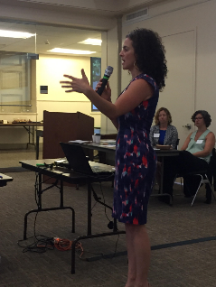
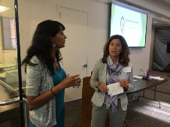
Session 2
Networking for Success
Presenter: Rebecca Fabiano, FabYouth Philly

Slide 7
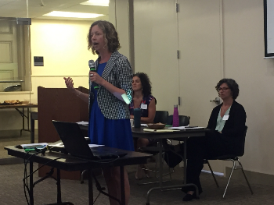
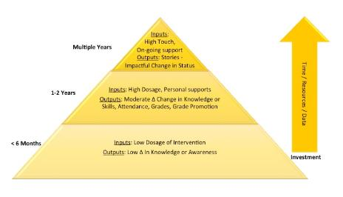
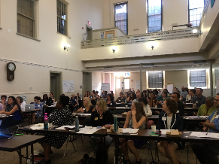
Session 3
Using Data to Communicate Impact
Presenter: Kasey Thompson

Slide 8
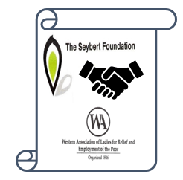
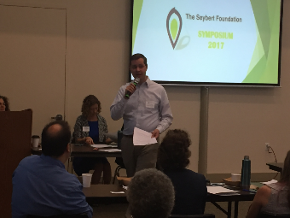
Announcing Seybert’s Historic Merger with Western Association
Rich Sedmak, President, Board of Directors

Slide 9
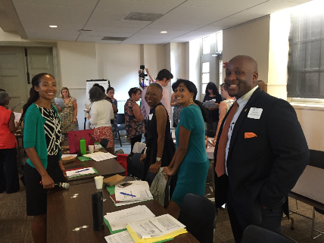
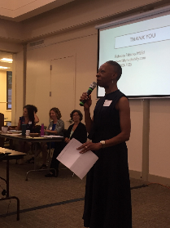
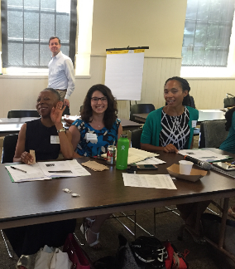
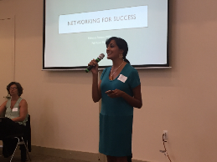
Acknowledging Seybert’s six Board members in attendance- now that’s dedication!
Linda A. White
Cicely Peterson-Mangum, Esq.
Deepa Vasudevan
Obinna I. Abara, Esq.
Marissa Meyers
Rich Sedmak

Slide 10
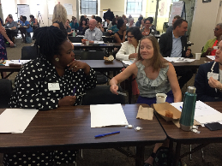
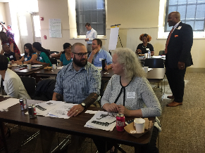
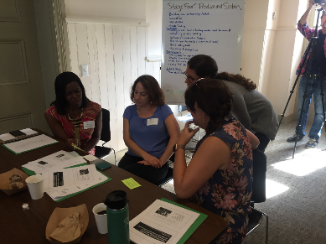
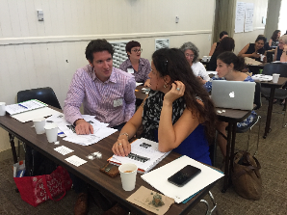
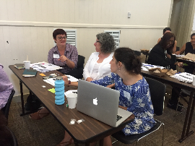
A Big Thank You to Seybert’s nonprofit partners for taking the time to learn and share ideas

Slide 11
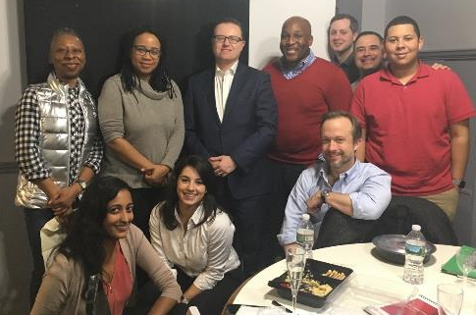
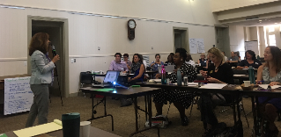
Encouraging Seybert’s Partners to Connect & Communicate
MANAGER
Diana Loukedis Doherty
TWITTER
@seybertphilly
WEBSITE
www.seybertfoundation.org
Members of Seybert’s Board of Directors participate in all site visits!

Slide 12
“Kudos on an excellent inaugural event! The energy in the room was amazing and the content was well thought out. I was also able to make some promising connections and share resources. Looking forward to the next Symposium. Many thanks to the planning team and the speakers!”
Feedback on Symposium 2017
“This symposium was one of the best I have ever attended...it was well organized, offered content that was unusually pertinent for [my organization] and I connected with 5 people I have been eager to meet and collaborate with! This is a wonderful gift to small nonprofits with similar focuses.”
“The symposium was an extremely useful event - not only for the information the presenters provided, but for re-connecting with many of our past project partners and peers! Thank you!”
“Thank you for organizing the symposium (many good "take-aways") and, even more for simply calling us together. The needs are so great in the city and yet, as one participant observed, there is an ingrained sense of competition because the "pot" of resources seems so small. The more we see and learn about each other and understand what, together, our impact is, the more open, I believe, we may be to collaboration and alignment.”
“The Seybert Symposium expanded its important support and created a tool for even greater impact for its grantees. It was thoughtful and well done. One thing that really stood out to me was the offer by Seybert to advocate for grantees with other funders. It gave me a wonderful feeling to learn there is another voice that will support our efforts to create greater awareness in the funding community.”
“Truly one of the best events of its kind I've attended in the last few years. The speakers were knowledgeable, on point, and relevant, and the timing of the morning flowed nicely. Thank you!”

